Slide 1
Biblical Performance Criticism
Inter-Semiotic Translation Seminar Misano, Italy March 7-11, 2011
James Maxey, Nida Institute

Slide 2
A Brief History of BPC
Biblical Theology Bulletin (2006) “Performance Criticism: An Emerging Methodology in Second Testament Studies.”
www.biblicalperformancecriticism.org
Wipf & Stock – monograph series in Biblical Performance Criticism

Slide 3
BPC Monograph Series
The Bible in Ancient and Modern Media: Story and Performance. Holly Hearon and Philip Ruge-Jones, editors.
From Orality to Orality: A New Paradigm for Contextual Translation of the Bible. James Maxey.
The Case for Mark Composed in Performance. Antoinette Clark Wire.

Slide 4
Forthcoming Titles – BPC Series
Orality and Literacy in Early Christianity. Pieter Botha.
Orality, Scribality, and the Gospel of Mark. Joanna Dewey.
Biblical Performance Criticism: An Emerging Discipline in New Testament Studies. David Rhoads and Joanna Dewey.
Orality, Performance, and Translation. James Maxey and Ernst Wendland, editors.
Performance in Early Christianity. Richard Horsley.
The Passion Narrative of Mark. Thomas Boomershine.
The Spoken and Written in the Gospels. Holly Hearon.

Slide 5
What is Biblical Performance Criticism?
“Briefly put, performance criticism seeks to re-imagine ancient Israel and the early church as predominantly oral cultures, to construct scenarios of ancient performances as means to interpret anew the traditions of the Bible, and to reorient the disciplines we use to study the Bible from a print model to an oral model of analysis.”

Slide 6
My shift in emphasis with BPC
Rather than an instrument for historical purposes (ancient performance), I am preoccupied with translation and BPC as a method that suggests performance as translation – rather than simply translation for performance.

Slide 7
The term “performance”
Public reading/Presentation/Proclamation
Rhoads: “We have chosen it because we now know that ancient performances were more than “presentations” or “recitations;” they were dramatic and artful, engaging and emotional, powerful and life-transforming, done usually by people with training or by people who had a natural knack for engaging people.”

Slide 8
My Assumptions
BT has always been inter-semiotic.
BPC is involved in a campaign of media democracy.
BPC asserts a fluidity of the “text.”
BPC places great value on memory.
BPC connects through story.
BPC presupposes a community.
Translation always – without exception – involves interpretation.

Slide 9
My Assumptions
BPC assumes that authority resides in the community.
BPC does not set itself in opposition to the historical critical method.
Reconstructed text as the point of departure.
BPC is a methodology of exegesis in and of itself.
In BPC the performance event is central.
BPC goes beyond orality.
BPC inherently is multi-media.

Slide 10
Ethnopoetics
Centrally concerned with the aesthetic patterning of oral literary forms and the problems of translating and rendering them in print in such a way that the artistry of their oral performance is not lost.

Slide 11
Genres and Canonicity
Locating Bible Translation within Translation Studies.
Comparing BT with other Religious Discourse Translation.
Comparing Religious Discourse Translation with the translation of other Canons.

Slide 12
BPC’s Link to Inter-Semiotic Translation
BPC does not simply involve translation – from one language to another.
BPC understands that performance itself IS translation.

Slide 13
Assumptions of BT to be revisited
Issues of fidelity and translation (Soukup and Hodgson)
Translation Studies offers numerous insights
  Re-writing
  Power relations
  Discussions of source/target

Slide 14
Limitations of BPC
Skopostheorie – purposes beyond performance
Contextualization

Slide 15
Lingering Questions
What exactly is a performance? Extra-Biblical?
Are the performances “the Bible”?
Questions of authenticity. – similarities with “authentic local/contextual theologies”

Slide 16
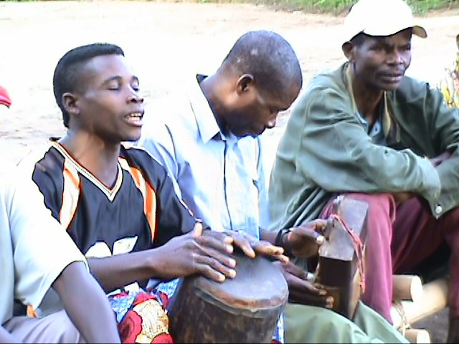
A Vuté Performance

Slide 17
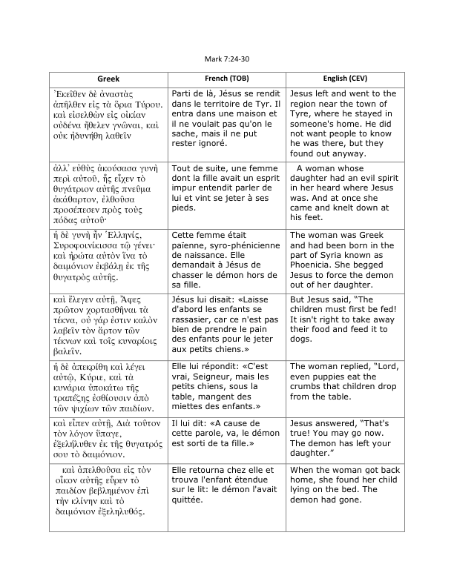

Slide 18
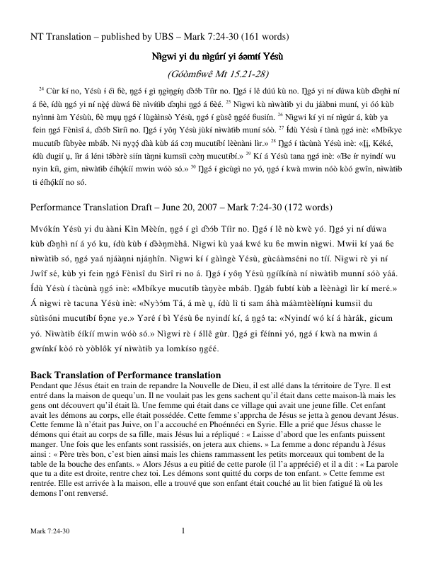

Slide 19
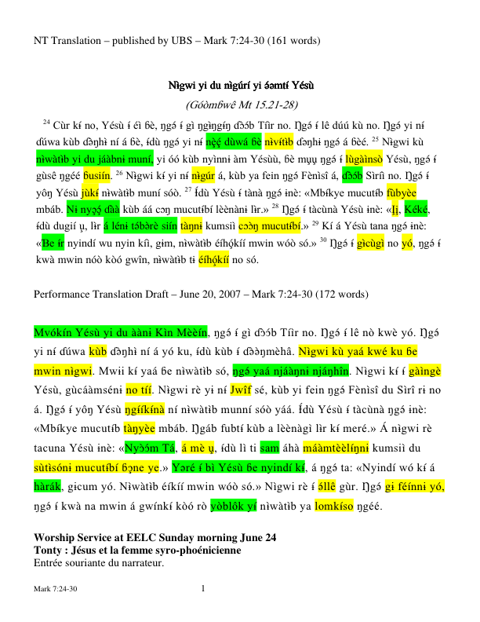

Slide 20
Nazareth Video

Slide 21
Biblical Performance Criticism
Inter-Semiotic Translation Seminar Misano, Italy March 7-11, 2011
James Maxey, Nida Institute

